Slide 1


The development of an effective Audio-Visual Horror experience in Virtual Reality
A Project Proposal presented to the Institute of Creative Technologies at De Montfort University
By Anthony Woodward BSc
In Partial Fulfilment of the Requirements for a Masters of Creative Technologies.
June 25th. 2021

Slide 2
What is the project?
Aims and Objectives:
Create an Interactive VR Experience that is viewed as immersive and engaging by testing participants.
Create an Interactive VR Experience that is viewed as scary and surreal by testing participants.
Distribute the VR Experience on a digital marketplace, with monetisation and marketing strategies in place to maximise profit and exposure.
Collaborate with Harri Bettsworth as the project composer to develop an Audio-Visual experience.
Nomenclature
VR: Virtual Reality
IOCT: Institute of Creative Technologies
MTI: Music, Technology and Innovation

Slide 3
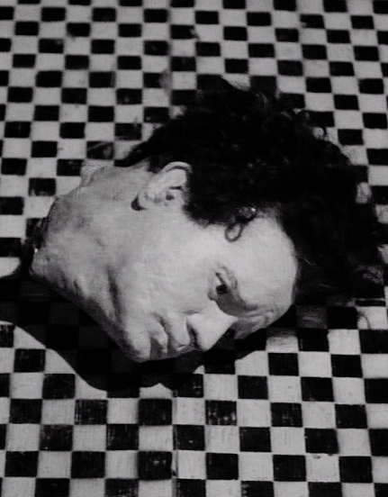
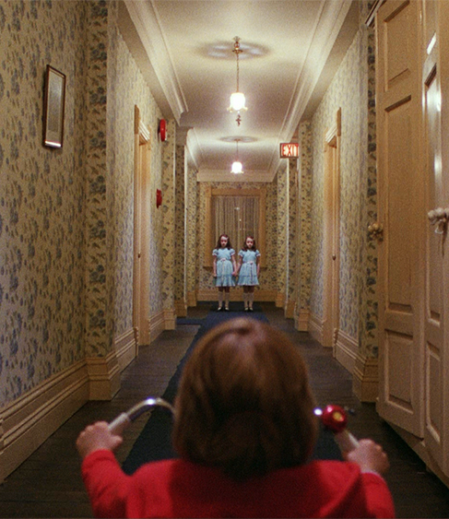
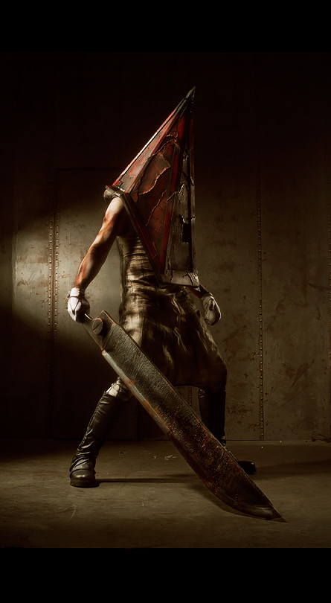
Contextualisation
Design Inspirations
Surreal and Uncanny
Notes:
The project began when discussions between Harri Bettsworth from the MTI course and I concluded with us wanting to collaborate on a game, with Harri wanting to focus on composing for a horror game for her work. The inspirations for the composing and game design are the same, with games and movies such as The Shining by Stanley Kubrick (1980), Eraserhead by David Lynch (1977), and Silent Hill 2 (Tsuboyama, 2001) directly influencing the sound and game design with their shared theme of Surreal Horror.
The theme of the design is surreal horror and the uncanny valley, which is a term to describe when things, such as people, seem to look realistic and lifelike, but not 100%. This is the feeling you get when you see a mannequin in the corner of your eye and think it’s a person, or the feeling that makes animatronic robots so creepy.
The theme of surreal horror is nightmarish, with dreamlike imagery and audio. Surreal horror is why clowns are scary. Surreal doesn’t have to be horror, as anything that causes the uncanny feeling is surreal, however exploring this theme with spatialised audio and VR imagery can lead to a truly terrifying experience.

Slide 4
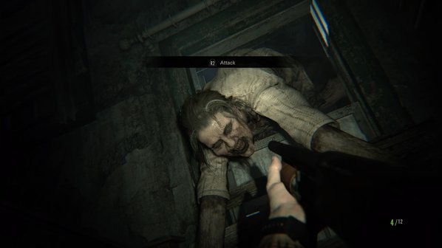
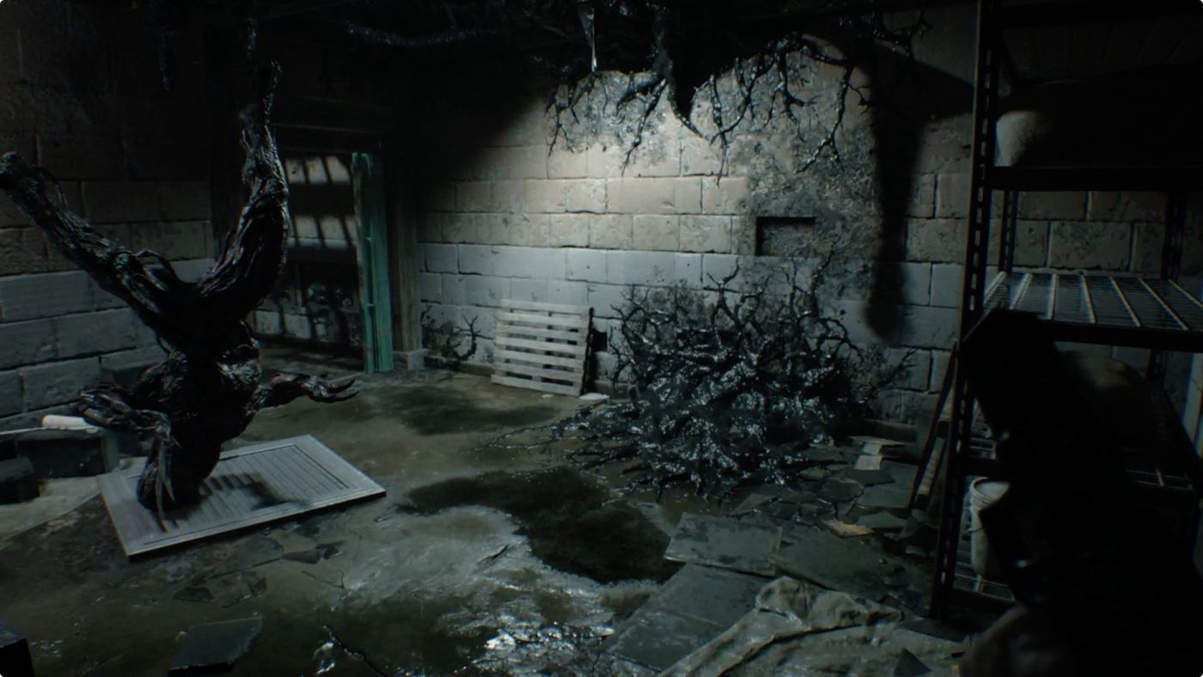
Contextualisation
Horror Games
Notes:
An example of a Surreal Horror VR game is Resident Evil 7 Biohazard VR. This original console game was ported to the VR platform, as if the original game wasn’t scary enough. RE7’s surreal horror experience is easily understood once you watch a 7ft woman climb through a window vomiting bees at you in VR. Resident Evil 7 is very successful at being an immersive and scary game, with amazing sound design to improve this, whether you are listening to heavy boots walking on the floorboards you are lay under, or whether you are listening to the big boss enemy smashing through walls as he chases you down hallways.
Resident Evil 7, and many other horror games are great inspirations on how to model environments and create scary moments throughout the VR experience I am developing.

Slide 5
Influences
Horror Cinema
VR Influences
Non-VR influences
The Shining,
Under the Skin
Eraserhead,
Midsommar,
Begotten
Paranormal Activity: The Lost Soul - PSVR, PC VR
Resident Evil 7 Biohazard - PSVR
Five Nights at Freddy's VR: Help Wanted - Quest, PSVR, PC VR
Phasmophobia - PCVR
Alien Isolation - MothrVR MOD - PC VR
Half-Life: ALYX - STEAM PC VR
No Mans Sky – PC VR PSVR
Silent Hill 2
Outlast
Dead Space
The Slenderman
Outer Wilds
Hellblade: Senua;s Sacrifice
Doom
Journey
Notes:
In terms of creating an audio-visual experience, the games Outer Wilds (Beachum, 2019) and Hellblade: Senua’s Sacrifice (Antoniades, 2017) have both influenced the design. The Outer Wilds soundtrack is played in part by multiple in game characters, slowly introducing the player to the soundtrack before giving them the ability to listen to all characters playing together. This way of incorporating the soundtrack into the game world engaged me immensely and similar effects would benefit my VR experience. Hellblade also uses immersive audio to improve the experience, using binaural audio to mimic psychosis. Similar effects could help build on the surrealist horror effect of my VR project.
To list some more non VR game influences;
Silent hill 2 uses unique sounds for its sound effects such as footsteps on broken glass to surprise the player constantly and to create an unsettling environment
Outlast limits on screen display to a hand camcorder that has nightvision to act as the players light source. This form of diagetic UI is great for immersing the player into the game play as the lack of information about the game state can increase anxiety, whilst also the lack of UI can help the player feel like they are the character being portrayed by the game.
Deadspace used a freaky and anxiety inducing soundtrack to intensify the visual jump scare horror aspect of the game, whilst focusing the visuals on quick gorey jumpscares. A lot of the horror in deadspace can be characterised as just plainly gross and not scary, a describing factor of a lot of Surreal horror experiences
Doom was one of the first games to use a heavy hitting soundtrack to keep the action going, simply by putting the player in a killing demons mood. Doom is a great example of how soundtracks can pace a game. Doom avoids silence to cause constant action, where a horror experience may use silence to cause constant anxiety
Of course there are also VR experience influences such as no mans sky, which has a vast suite of options to enable inclusivity in their VR games, like toggling the rendering of the player character to help people with motion sickness issues. Horror experiences often lack inclusivity options as being helped during a horror experience can often stop it from being scary, however I believe inclusivity is important in a medium such as VR due to the increased physical demand of the platform.
Five Nights at Freddy’s VR is also worth mentioning, as the whole game takes place from one location with the player being unable to move around, the entire horror experience is built on immersive audio backed up with visual jumpscares.

Slide 6
The Design
PC VR vs Standalone VR?
Unity vs Unreal?
Game Rules
Technical Details
Technology Limitations and Solutions
Story revealed through game, understanding only at end, this is done by leaving objects that tell the story, either written notes or clues to the investigation
The player can't influence the story, and can only influence the order of events
There are no enemies or hazards, player can only get reset by not paying attention and getting caught in a trap
Majority of game in-doors, this removes the need for an exterior and reduces draw calls and GPU overdraw
The entire game should give the perspective of the character, meaning no On-Screen HUD, No pause menu and no other hardware requirements other than the headset and the controllers
The game is driven by audio, and therefore it is recommended that players can hear effectively to experience the game. Despite this, Closed Captioning may be included to aid players with issues processing the directional audio
Environment: Spooky yet real. Uncanny feeling. Liminal spaces
Interactable items: Buttons, Switches, Flashlights + more interactables
Immersive Spatial Audio and game soundtrack: All sound composed by Harri Bettsworth with technology such as Binaural microphones being used
6DoF tracking: Uses Headset tracking to give player full VR perspective
Hip based locomotion: Experimenting with hip based locomotion
Guardian space: If using Oculus, Ability to set guardian space
Quest 1 headset not very powerful
Solution: use PC VR and develop for OpenVR so PC headsets can be used
Acquire an Oculus Quest 2
Reduce runtime changing of Meshes, Materials and Shaders, however changing textures and mesh complexity okay.
Cannot move around the virtual environment with physical movement
Teleportation anchors that can be used with the controllers to move around the scene
Move and rotate with the thumb sticks
VR backpack PC's with constant physical space
Limited scope due to market share of headsets
use OpenVR in Unity. Loses some oculus features but makes it simple to release the experience on non-oculus headsets
Focus on Quest platform due to highest share of market
Wwise vs Steam Audio vs FMOD vs Engine Default
Notes:
I split theinitial experience design into 3 sections, the story rules, the technical details and the technical problems.
The experience rules are simple, as the player makes their way through the narrative, the story will slowly be revealed to them through interaction with objects throughout the scene. As you progress through the experience, the realism starts to fade away and surreal uncanny horror events start to unfold. The story will be linear, however it can be experienced in multiple ways, with most of the experience being in-doors in the same environment. Its important to design the game with audio in mind, the soundscape will receive a lot of focus during development.
Some of the technical details are obvious such as interactable items and 6 degrees of freedom vr headset tracking, however new methods such as hip tracking may be used to improve the movement experience throughout the game, and the environment will be realistic but also surreal, so intensive effects will be used.
Lastly, you can see some technology limitations and some of the possible solutions. Such as wanting to use the Oculus Store due to having a larger market share which would require the use of an Oculus headset, forcing the experience to work on a standalone headset to get effective use of said marketplace.

Slide 7
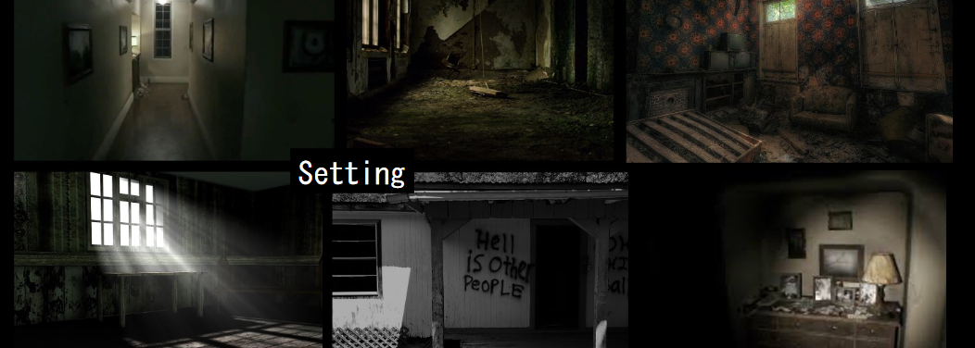
Prototype story
The Story and Environment plan
Notes:
The story hasn’t been developed for the experience fully, however some details are already clearly in-place.
Game starts grounded in realism and then slowly shifts into uncanny, surrealism and creepy
Player controls a Cop character, who is entering a property where suspicious behaviour has been noted.
Cop gets locked into the house, with the door disappearing behind him
Player is given initial details over the radio, but the player has to work out whats going on by themselves, using story objects and events scattered around the home
the home changes in layout and appearance, with other characters some times appearing just out of reach
Cop is outfitted with some equipment, such as a loaded gun (Thats pointless), a crappy flashlight and a non-functioning radio
The radio eventually starts making noises too, with those noises soon transitioning into sounds coming from inside the characters mind
Goal is to escape the home alive

Slide 8
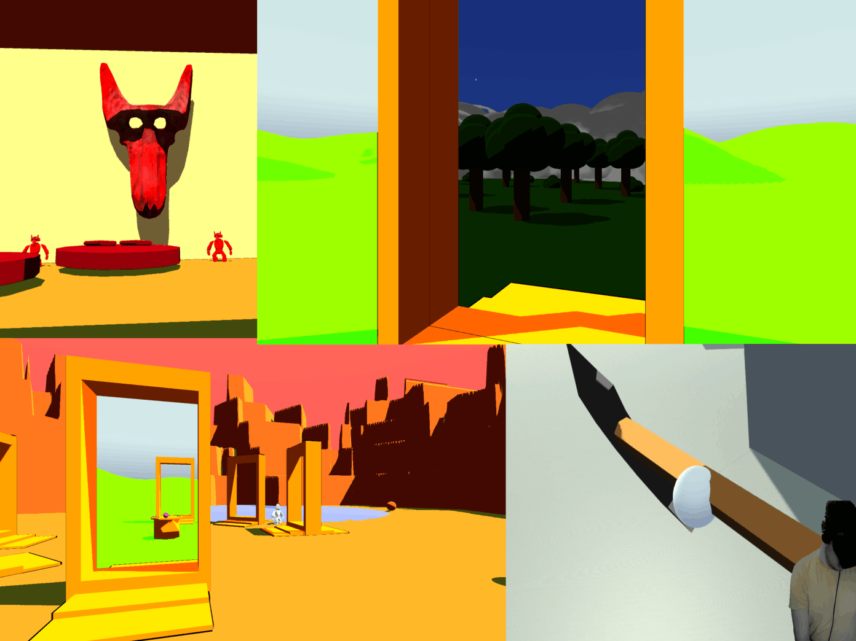
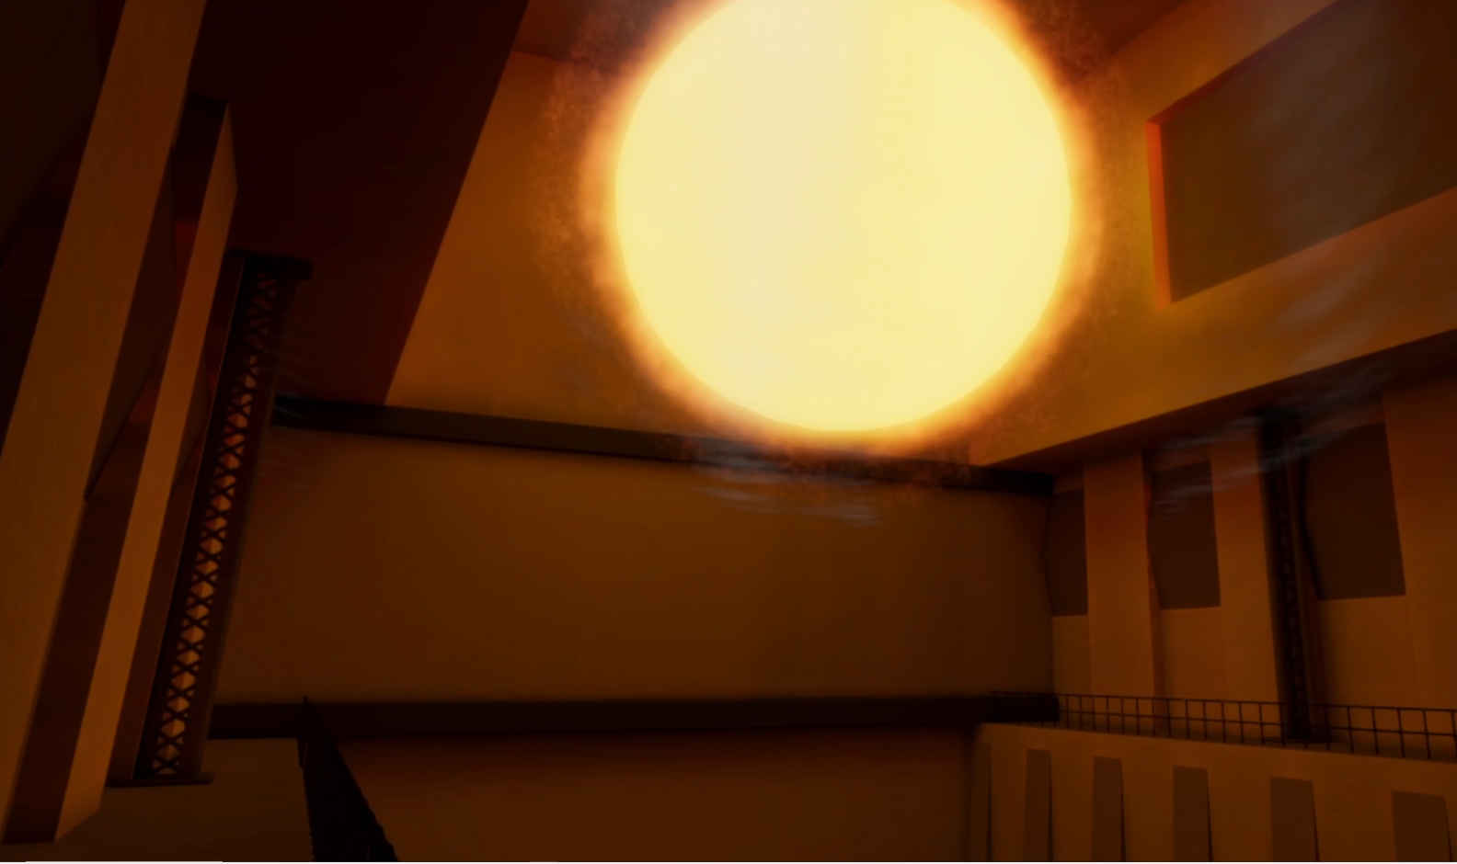
The Development
Methodologies and Strategies for Research and Development
Notes:
In the past, I have worked on multiple VR and non-VR games, with VR examples being Void, a VR exploration game, and Unlikely Things, a VR artwork experience. My experience with VR and game development is in Unity, A game development tool, and therefore this will be the tool I use to develop my VR major project. Aspects such as virtual reality locomotion, interaction and spatialised audio are features I have developed before, with advanced lighting and special effects also being features I am familiar with developing. This leads me to the prototype. This proposal and experience design has been developed alongside a Horror VR prototype, that has interactable items such as flashlights, knobs, and levers, with interactive spatialised audio with closed captions all pre-developed. This enables me to be more confident in the 10-week development cycle of the project.
Frameworks such as Guiding with a Soft Touch by Mark Tempini (2019) will be used to develop strategies for directing the players attention, and frameworks for immersing users in virtual reality (Kanamgotov, 2015) will be followed to help create a truly engaging Audio-Visual horror experience.
This practice-based research project is being tackled with a methodology developed by Candy and Edmonds (2018) due to my experience with the techniques outlined. The overall focus of the project isn’t to necessarily develop new research for the field, but instead to apply research from the field into a practical project. By using a RIPA style of prototyping, something that is usually apart of my development strategies, I will be able to collate research and develop techniques and practices for creating immersive Audio-Visual VR experiences. Whilst designing the VR experience, a 6-part methodology from Polcar, Gregor, Horejsi and Kopecek, (2016) will be used to help generate a methodical approach to tackling the development as the project grows in size and scope. This will in-turn enable me to develop new research for the field, despite it not being a specific aim of the project to do so.

Slide 9
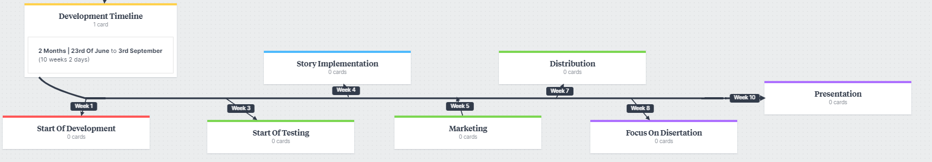
Project and Team Plan
Notes:
The timeline from development begins at week 1 with initial development, with testing beginning at week 3. I plan to then by week 4 have a solid prototype that I can then begin implementing a story into the experience. Then between week 5 and week 8, marketing and distribution will begin, with a social media campaign and digital store rollout, with the final weeks left allowing be to focus on polish and developing a website and a transmedia storyline to generate interest with the project.
The development and audio composition will be done separately, with Bi-weekly meetings and GitHub being used to implement Harri’s composition progress into the experience. This mitigates the risk of any teamwork issues, as most of the work will be done independently. I use GitHub to store the files and keep track of version changes, with a Kanban board to track the experience development and keep progress at a steady pace. Development of the project will use both the Oculus integration and the OpenVR integration, allowing the project to switch platform and headset brand easily if issues arise with hardware.
For my own personal plan, as I just mentioned I will be using a Kanban board to track what tasks I have to do, what is in progress and what has been complete. Feedback from tests will be converted into bug reports that can be added to the Kanban board so I can keep track of what fixes need to be done. Alongside this, I will be keeping a research diary along with Harri Bettsworth, so we can look back at the work we have done to see what could be done better. This allows me to develop with a reflective cycle as a guideline.
Talk about reflective cycles
kolbs experiential learning

Slide 10
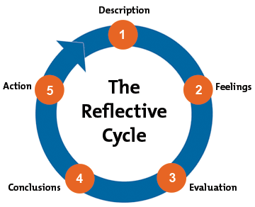
Gibbs Reflective Cycle
Notes:
Graham Gibbs developed the reflective cycle in 1988. The stages of the cycle are as follows:
(Initial experience)
Description “What happened? A simple description of events."
Feelings "What were your reactions and feelings? "
Evaluation "What was good or bad about the experience?."
Analysis "What sense can you make of the situation? Bring in ideas from outside the experience to help you” “Were different people's experiences similar or different in important ways?"
Conclusions (general)"What can be concluded, in a general sense, from these experiences and the analyses you have undertaken?"
Conclusions (specific)"What can be concluded about your own specific, unique, personal situation or way of working?"
Personal action plans "What are you going to do differently in this type of situation next time?""What steps are you going to take on the basis of what you have learnt?“
By using this reflective cycle throughout development alongside a research diary, my creative practice will be able to evolve before the project is finished, which will be helpful if I am to try and create a polished product at the end.
As a part of the evaluation can use other peoples experience, its important for me to know what aspects of the development I am going to expose to testers and what I hope to gain from them.

Slide 11
Testing, Marketing and Distribution
Use myself, peers, and other volunteers to perform two categories of tests
Test the games implementation, what features work and what features don't, find bugs, etc.
Test to see if scary, uncanny, surreal. Test to see if immersive and what would improve the experience
Social Media Instagram, Tiktok, Facebook, LinkedIn, YouTube, Blog. use social media platforms to advertise the game, and blogs to document the development process
Website Create a simple website for the project that has links to distribution pages
Email Emailing people about the project to try and develop interest
Transmedia Use transmedia storytelling through website and social media to help build the game world and give clues to the story for anyone interested in the project
Steam VS Itch VS Oculus Store
Market Share which digital store has the highest market share on the platform I am using?
Pricing Should the game be priced? What do other VR games on the market go for? What cut does the distributor take?
Additional features What additional features does the store offer?
Marketability How easy is it to market the game on each platform?
Notes:
As shown on the work plan earlier, testing, marketing, and distribution are all mentioned.
The project will be tested in two ways, both of which will have participants selected from friends and colleagues, and also random volunteers from the VR community. The two types of tests are;
Testing for bugs, issues with interaction, testing how the game generally feels and what can be improved
AND
Testing to see if the experience is unsettling and scary, and to test to see what can improve this experience.
Marketing is also going to take a large place in this roject, as one of the aims is to successfully distribute a product. Social media will be used alongside a transmedia storyline to try and generate interest in the project and to link people to store pages where the experience is distributd.
To do this however, decisions have to be made with the distribution. What platforms should be used? Should the product be priced? what share will the platforms take? How effective is the platforms marketability? These questions can only be answered with deep research and an understanding of where the audience of the project will be further down the line.

Slide 12

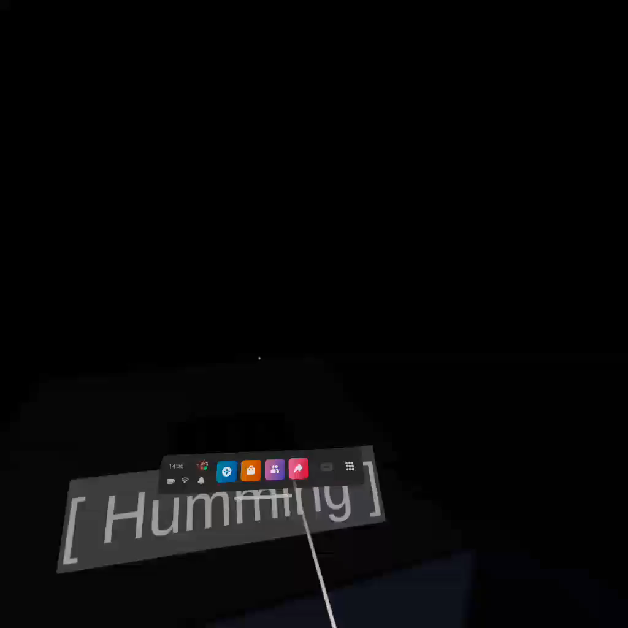
Confidence in Project
Notes:
Risk management is important with a project of this side, however I thought it would be best to demonstrate first why I am confident with the project.
This is a simple beginning prototype for the project, but already you can see that the important features of the game are taking place, with custom player interaction and interactive spatialised audio. Features such as closed captioning are demonstrated here to show how different techniques can be used to help create a more intuitive experience for some users

Slide 13
References
The Shining. (1980) [film] Dir. by STANLEY KUBRICK. Elstree Studios, Ltd., Borehamwood, England: Stanley Kubrick
Eraserhead. (1977) [film] Dir. by DAVID LYNCH.Center for Advanced Film Studies, American Film Institute: American Film Institute
TSUBOYAMA, M. (2001) Silent Hill 2. Tokyo: Konami Computer Entertainment Tokyo
MURRAY, S. (2019) No Mans Sky VR. Guildford, England: Hello Games
BEACHUM, A. (2019) The Outer Wilds. Los Angeles, California: Mobius Digital
ANTONIADES, T. (2017) Hellblade: Senua's Sacrifice. Cambridge, UK: Ninja Theory
Tempini, M., 2019. Guiding with a Soft Touch: Directing Players in Nonlinear Levels Without UI. Press Start, 5(2).
Kanamgotov, A., 2015. A framework for immersion in virtual reality. Ph.D. University of Bedfordshire.
Candy, L. and Edmonds, E., 2018. Practice-Based Research in the Creative Arts: Foundations and Futures from the Front Line. Leonardo, 51(1), pp.63-69.
POLCAR, J. et al. (2016) Methodology for Designing Virtual Reality Applications. Available from https://www.researchgate.net/publication/311662441_Methodology_for_Designing_Virtual_Reality_Applications
Gibbs, Graham (1988). Learning by doing: a guide to teaching and learning methods. London: Further Education Unit. ISBN 978-1853380716. OCLC 19809667. Retrieved 10 November 2011.

